Slide 1

ADDRESS HANDBOOK

Slide 2
Abstract :
The Address Handbook in C++ is a software application designed to efficiently organize and manage contact information. This program provides a user-friendly interface for users to input, search, update, and delete contact details, making it a valuable tool for personal and professional use.
The add Address function takes a reference to a vector of Address objects and allows the user to input a new address. It prompts the user to input the name, street, city, state, and ZIP code for the address and stores it in a new Address structure. The new address is then added to the vector using push back.
The display Addresses function takes a reference to a constant vector of Address objects and displays the addresses stored in the vector. It iterates through the vector and prints each address's name, street, city, state, and ZIP code.

Slide 3
In the main function, an empty vector called address Book is created to store multiple addresses. The program then enters an infinite loop, displaying a simple menu for the user to choose from.
The menu in the main function allows the user to perform the following actions:
1: Add a new address by calling the add Address function.
2: Display all addresses in the address Book by calling the display Addresses function.
3: Exit the program. The program reads the user's choice and uses a switch statement to execute the corresponding action based on the choice. If the choice is invalid, it informs the user and allows them to try again

Slide 4
INTRODUCTION:
A basic console application that lets a user manage an address book is written in C++. The following features are offered by the program .It specifies an address structure with fields for the name, street, city, state, and ZIP code of an individual. This structure represents an individual's address. Two functions are defined in the code: add Address: To add a new address to the address book, use this function. When a new address is entered, the user is prompted, and the information is stored in the address book vector. Display Addresses: All of the addresses that are presently kept in the address Book vector are shown by this function. In the primary role: To hold addresses, it first initializes an empty vector called Address Book. It then starts a while loop that lasts until the user decides to end it. A prompt asks the user to enter their selection. Depending on the option selected by the user, the application either exits if option 3 is chosen or runs the associated function, such as display Addresses to display the addresses or add Address to add an address. The user can add more addresses and have them shown while the software keeps running in a loop until they decide to stop by choosing option 3. This code is a basic illustration of how to use standard input/output and C++ to create and maintain a basic address book. In addition to adding addresses, users can browse the stored addresses and stop the program.

Slide 5
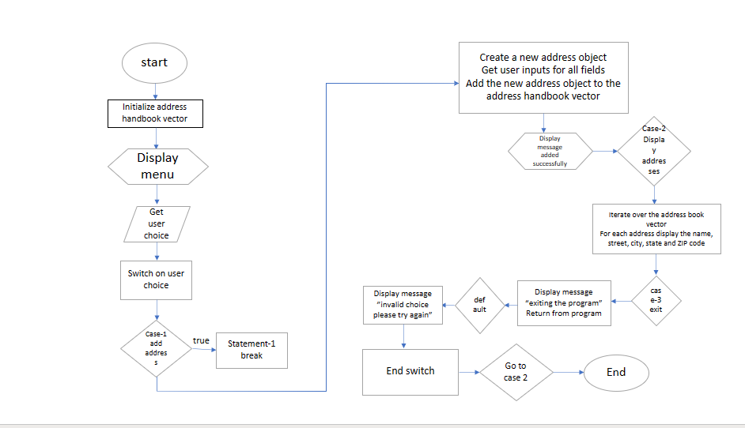
DFD:

Slide 6
Flow chart:
Start
-> Initialize address Book vector
-> Display menu
-> Get user choice
-> Switch on user choice
-> Case 1: Add address
-> Create a new Address object
-> Get user input for all fields
-> Add the new Address object to the address Book vector
-> Display message "Address added successfully!"
-> Case 2: Display addresses

Slide 7
-> Case 2: Display addresses
-> Iterate over the address Book vector
-> For each address, display the name, street, city, state, and ZIP code
-> Case 3: Exit
-> Display message "Exiting the program."
-> Return from the program
-> Default: Display message "Invalid choice. Please try again.“
-> End switch
-> Go to step 2EndFlowchart

Slide 8
Methodology:
Object-oriented programming (OOP): The program uses OOP concepts such as classes and objects to represent addresses. This makes the code more modular and reusable . Top-down design: The program is designed in a top-down manner, starting with the main function and then breaking it down into smaller subroutines. This makes the code easier to understand and maintain . Structured programming: The program uses structured programming techniques such as loops, conditional statements, and functions. This makes the code more readable and efficient.
Top-down design: Top-down design is a software design methodology that breaks down a complex problem into smaller and more manageable subproblems. The subproblems are then further broken down until they are simple enough to be solved individually .

Slide 9
In the address book program, the main function represents the top-level problem. The main function calls two subroutines: add Address() and display Addresses(). The add Address() subroutine adds a new address to the address book, and the display Addresses() subroutine displays all addresses in the address book.
Structured programming: Structured programming is a programming paradigm that emphasizes the use of control structures such as loops, conditional statements, and functions. Control structures allow programmers to organize their code in a clear and concise manner . In the address book program, the add Address() subroutine uses a loop to get user input for the address information. The display Addresses() subroutine uses a loop to iterate over the address book and display the address information for each address . Overall, the address book program is well-written and uses a variety of programming methodologies to make it modular, reusable, readable, and efficient.

Slide 10
CODE:
// Function to add a new address to the address book
void addAddress(std::vector<Address>& addressBook) {
Address newAddress;
std::cout << "Enter name: ";
std::cin.ignore();
std::getline(std::cin, newAddress.name);
std::cout << "Enter street: ";
std::getline(std::cin, newAddress.street);
std::cout << "Enter city: ";
std::getline(std::cin, newAddress.city);
std::cout << "Enter state: ";
std::getline(std::cin, newAddress.state);
std::cout << "Enter ZIP code: ";
std::getline(std::cin, newAddress.zip);
addressBook.push_back(newAddress);
std::cout << "Address added successfully!" << std::endl;
#include <iostream>
#include <string>
#include <vector>
struct Address {
std::string name;
std::string street;
std::string city;
std::string state;
std::string zip;
};

Slide 11
// Function to display all addresses in the address book
void displayAddresses(const std::vector<Address>& addressBook) {
std::cout << "Address Book:" << std::endl;
for (const Address& address : addressBook) {
std::cout << "Name: " << address.name << std::endl;
std::cout << "Street: " << address.street << std::endl;
std::cout << "City: " << address.city << std::endl;
std::cout << "State: " << address.state << std::endl;
std::cout << "ZIP: " << address.zip << std::endl;
std::cout << "-----------------------" << std::endl;
}
}

Slide 12
int main() {
std::vector<Address> addressBook;
while (true) {
std::cout << "Address Handbook" << std::endl;
std::cout << "1. Add Address" << std::endl;
std::cout << "2. Display Addresses" << std::endl;
std::cout << "3. Exit" << std::endl;
std::cout << "Enter your choice: ";
int choice;
std::cin >> choice;
switch (choice) {
case 1:
addAddress(addressBook);
break;
case 2:
displayAddresses(addressBook);
break;
case 3:
std::cout << "Exiting the program." << std::endl;
return 0;
default:
std::cout << "Invalid choice. Please try again." << std::endl;
break;
}
}
return 0;
}

Slide 13
OUR TEAM
A.Naga Visalakshmi – AP22110010917
L.Manvitha – AP22110010939
K.Meghana – AP22110010968
V.Manasa – AP22110010977

Slide 14

Thank you

